Slide 1
ELECTRIC MOTOR FAULT DETECTION SYSTEM USING IOT
TEAM MEMBERS : HIMABALA - CB.SC.U4AIE24028
NIKHIL - CB.SC.U4AIE24053
SANDEEP - CB.SC.U4AIE24047
CHAITHANYA - CB.SC.U4AIE24040

Slide 2
INTRODUCTION
Our project main theme is to build a real time motor monitoring system using an iot software
The ability to identify faults in electric motors is crucial for preventing failures that lead to operational disruptions, safety hazards
Electric motors are vital components in numerous applications in various industries
Understanding their operational principles and common failure modes is key for effective fault detection.
Our project is implementing an iot software with is connectivity with motor has by using the ESP8266 and we can observe motor by continuously and we can get alerts to our mobile

Slide 3
OBJECTIVE
Understanding their operational principles and common failure modes is key for effective fault detection, by that we can train our model in any situations.
We can find the three major faults like overheating , vibration , electrical imbalance etc…,
By using this we can reduce unplanned downtime and increase equipment lifespan. And the health of a motor will increase.
The main objective of an ESP8266 is to collect the data and analyze data to support predictive maintenance strategies
By processing vibration data instantly, the system can detect faults before they lead to serious failure

Slide 4
WORKING PRINCIPLE
Sensors that are installed near the motor to tract and maintain the motor will measure the data
The data will be sampled continuously and transmitted to the central processor unit
If the module detects any abnormal patterns (threshold breaches) are detected using and this which we trained the motor .
it will send abnormalities to the microcontroller it will send the information via iot like using Wi-Fi/Bluetooth .
The alerts are sent via SMS / E-mail/mobile app for a quick actions .

Slide 5
BENEFITS
Real-time alerts will be more helpful to take an immediate detection of faults prevent the motor damage.
Remote monitoring it will be accessible from anywhere using mobile / web browser
While coming to cost saving it will reduces the unnecessary maintenance and it is useful to improve the motor life
Data Driven maintenance it will move from reactive to the predictive strategies
It will increases the up time to minimizes the disputes in the industrial operations

Slide 6
METHODOLOGY
We identify the need for real- time fault detection in electric motors by analysing common issues like overheating , excessive vibration , and current fluctuation , which leads to severe damage & unplanned downtime.
An iot-based system architecture was designed with key components such as vibration sensor , a microcontroller(ESP8266),and a cloud platform for monitoring system and alert management
A hardware setup was developed where sensors were connected to the microcontroller and mounted onto the near the motor ensuring accurate data and capture from physical condition
Threshold-based logic was implemented to detect abnormalities when a parameter exceeded its safe limit, the system triggered an alert through app notifications or emails and optionally activated a relay to shut down the motor.

Slide 7
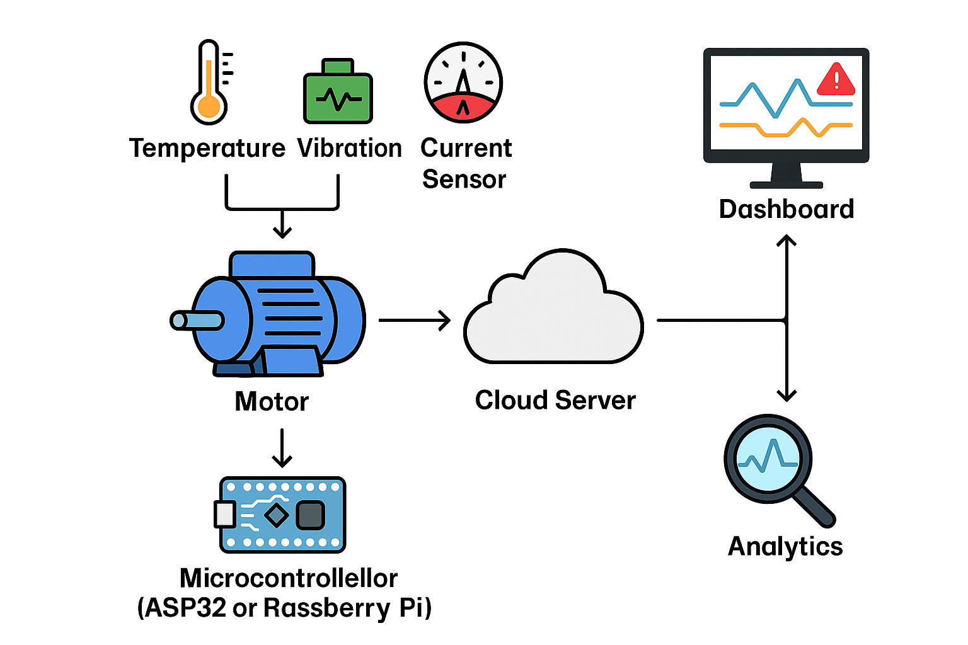
WORK FLOW
The sensors and motor were connected to the microcontroller
The sensor were in the near by of the motor and it will continuously observe the motor
It will send the data via using Wi-Fi to the iot software like app / web
We will train the data to detect the motor with giving the some amount of minimal threshold energy . It will check the data every time if the microcontroller get the new data .
While calculating the data it will anilazines the data wither is there any issue or not
If it sense any issue it will send to signals to the iot software it will send us an alert notification to us

Slide 8
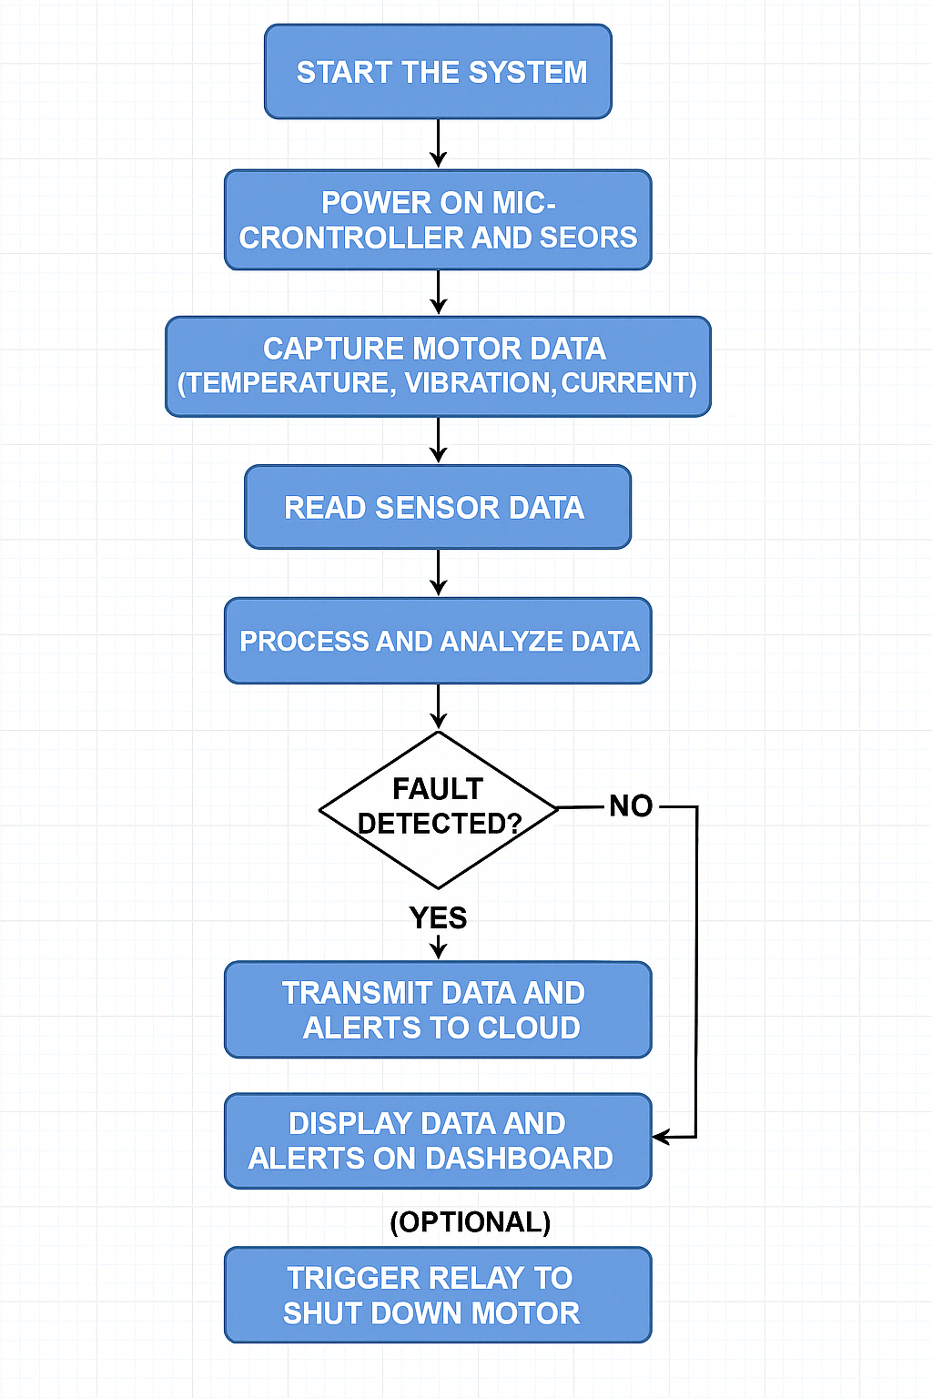
FLOWCHART

Slide 9
PROBLEM STATEMENT
Sensor Accuracy will be low if the sensor will get week/damaged it will give false readings.
Connectivity issues will leads to poor network infrastructure may interrupt data flow.
Power supply will be the major issue for the microcontroller and vibration sensor want to be stable power supply
The main thread is on information security the data needs to be secure while transmission and access.

Slide 10
FUTURE SCOPE
AI-Powered Diagnostics we can use historical data to predict of wrong failures
Edge computing will perform analystics locally for the faster response
Energy Monitoring will help to track motor efficiency and the data usage
Automated Maintenance which leads to trigger services to order of its own automatically

Slide 11
conclusion
Iot enables smart , proactive motor monitoring and fault detection.
It helps to industries ti improve the reliability & safety & its own efficiency
It is a step forward towards industries to be in the smart factories

Slide 12
REFERENCES
[1] I. A. Helal et al., “Motor Fault Detection Using Vibration Patterns,” IEEE Sensors, vol. 19, pp. 1205–1211, 2022. [2] A. Kotp et al., “Vibro-Acoustic Fault Diagnosis Using ANN,” Int. J. Adv. Comput. Sci., vol. 11, no. 6, pp. 456–461, 2021. [3] J. Lee, “Spatiotemporal GRU for Fault Detection,” IEEE Trans. Ind. Electron., vol. 67, no. 8, pp. 6832–6840, 2020. [4] P. Kumar, “Deep CNN in Motor Health Monitoring,” Int. J. Autom. Comput., vol. 18, no. 3, pp. 351–359, 2022. [5] S. Sharma, “Real-Time ML for Motor Anomaly Detection,” IEEE IoT J., vol. 10, no. 2, pp. 1912–1920, 2023. [6] M. Singh et al., “Wireless IoT for Predictive Maintenance,” Proc. IEEE IoT Conf., pp. 211–216, 2021. [7] H. Lin et al., “Smart Motor Monitoring in Factories,” IEEE Access, vol. 9, pp. 22415–22425, 2021. [8] R. Patel, “ESP8266 Monitoring in Agriculture,” Sensors, vol. 22, no. 3, pp. 317, 2022

Slide 13
MOTORGUARD
- Detects motor faults using vibration data
- Real-time health monitoring and alert notifications
Our project, Motor Guard, is a smart system that keeps a constant check on the health of electric motors using vibration analysis. The idea is to monitor the motor in real time and immediately detect any unusual vibration patterns that could signal a fault—helping to prevent bigger failures. It’s like having a smart guard for your motor that can predict problems before they happen.

Slide 14
Our Objective
- Predict motor faults early using a vibration sensor
- Alert users through a digital interface
The main goal behind Motor Guard is simple yet powerful—to catch faults at their earliest stage and give users a proper heads-up. We do this by attaching a vibration sensor to the motor. Whenever the motor starts behaving unusually, the sensor picks it up and sends that data to our web interface, where users can check alerts instantly.

Slide 15
What We Built So Far
- Fully designed HTML interface with navigation
- Functional login, signup, and UI for alert and data pages
Though we couldn't fully convert it into a mobile app due to time limitations, we’ve completed a fully professional HTML/CSS-based UI called MotorGuard. We have structured it like a real-world app—with login, signup, dashboard, alerts, and data pages. Every section is interactive and user-friendly, made using clean design and modern elements.

Slide 16
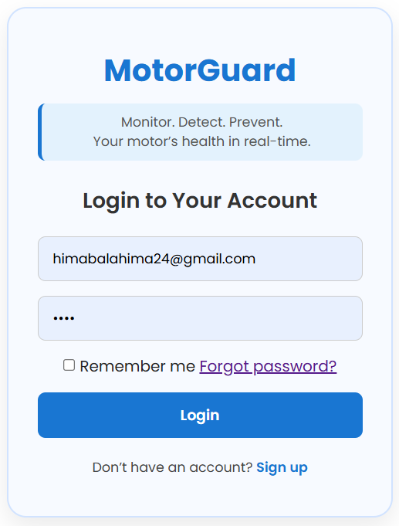
Key UI Pages - Login and Signup
- Clean, minimal login/signup with input validations
- Includes “forgot password” and user-friendly prompts
Our login page is designed to give a real app-like feel—users can enter their credentials, recover their password, and sign up if they're new. The design is sleek, with calming colors and modern typography, making the first impression really professional. It’s designed not just to look good but to feel intuitive too.

Slide 17
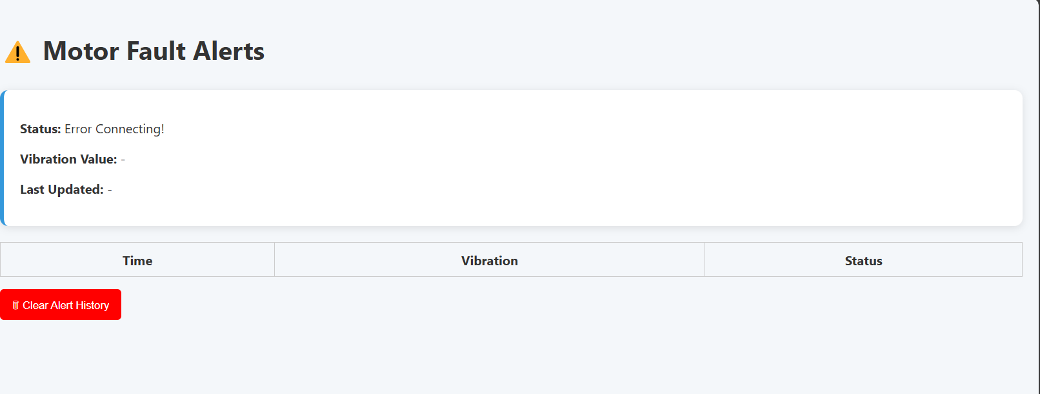
Alerts & Data Page
- Alerts.html: Displays motor fault messages in real-time
- Data.html: Shows vibration readings and system logs
We created two important pages that show exactly how the system would work: alerts.html is where users get instant notifications if any fault is detected in the motor. data.html is like a live dashboard that shows raw vibration data, letting users understand the motor’s condition in depth. These two pages are the heart of real-time monitoring.

Slide 18
What’s Next
- Connect to real-time sensor hardware via ESP8266
- Convert app using proper hosting + deploy on Play Store
The next step is to integrate the sensor’s real-time data using the ESP8266 module, and host the project on a live server. Once that’s done, converting it into a downloadable app or deploying it to the Play Store will be straightforward. We’ve already laid the entire foundation—we just need the final pieces connected.

Slide 19
Conclusion
- Complete working prototype ready for next phase
- Practical, real-world solution for motor safety
To sum up, Motor Guard isn’t just a project—it’s a real-world system that’s already 80% there. We’ve built a clean, usable interface, planned out hardware connectivity, and even explored app conversion. With just a few final steps, this will be a fully deployable and extremely useful system in industrial setups.

